Slide 1


UDP, Complete compare, and Generating Reports
By: Group 3
Notes:
Hi, this is our group HW we had to delegate some group members to work on this while the rest of the group worked on the project to promote concurrency, and to ensure project completion.

Slide 2
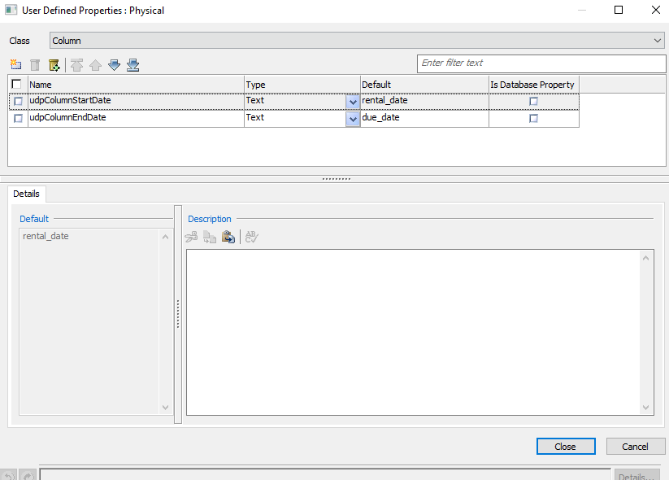
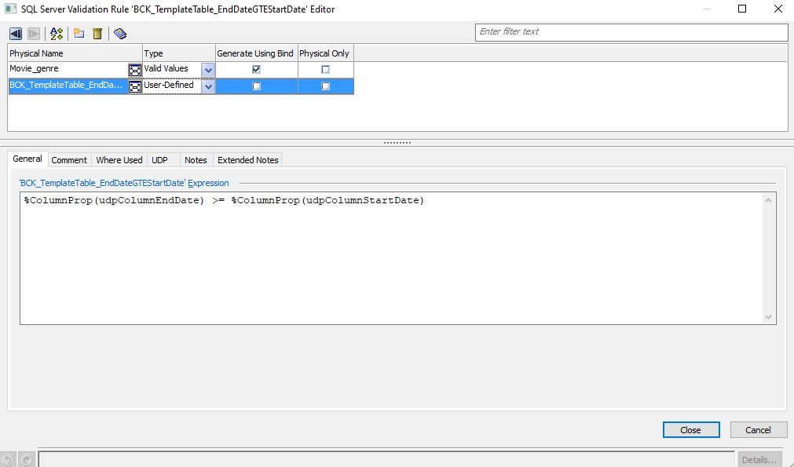
UDP Creation, validation creation
Notes:
eMovies model by default does not include any UDPs so we created 2 and added our own, one called udpColumnStartDate, and the other calling udpColumnEndDate. After creating the udp we applied it to the Validation rule called EndDateGTEStartDate, with udpColumnEndDate being greater than or equal to SudpColumnStartDate ensuring that in our context of eMovies, the due_date will come after the rental_date.

Slide 3
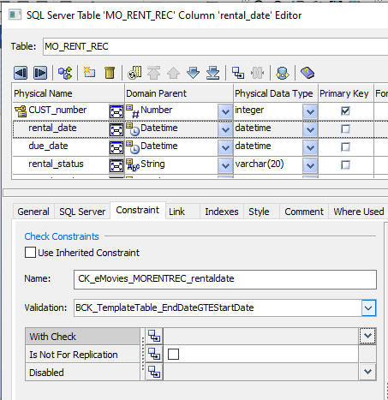
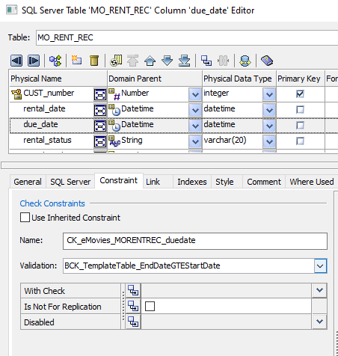
Applying UDP to Validations
Notes:
Applying validations to both rental_date column and due_date column under MO_RENT_REC allows us to ensure that rental_date always comes before the due_date and vise versa.

Slide 4
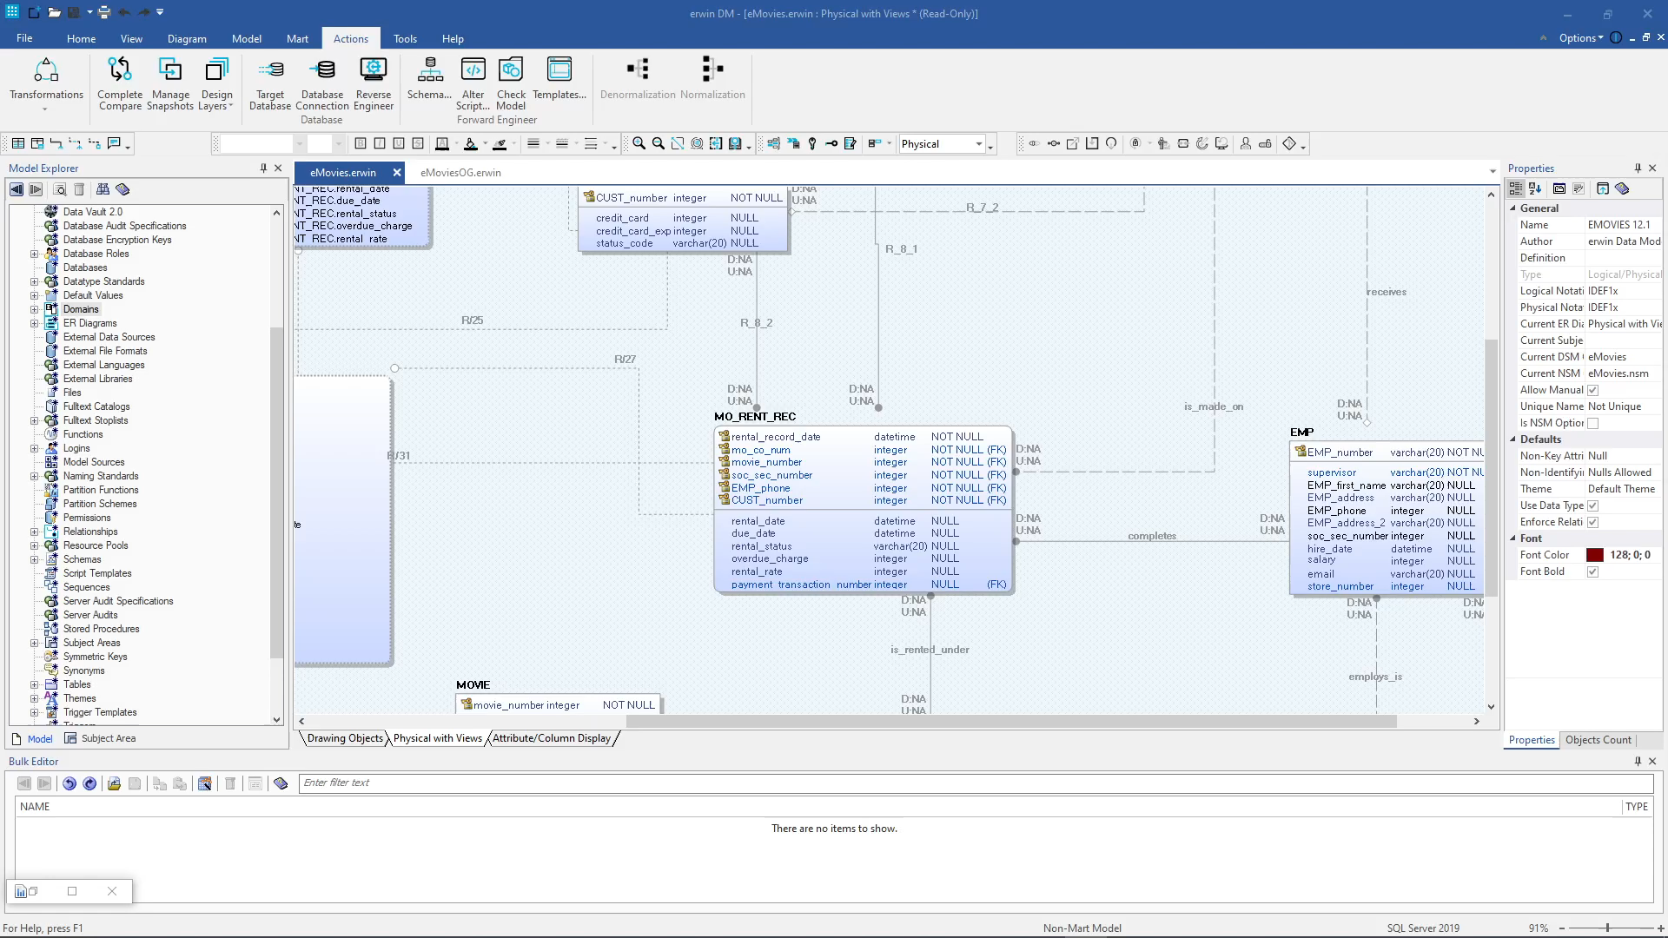
Complete Compare

Slide 5
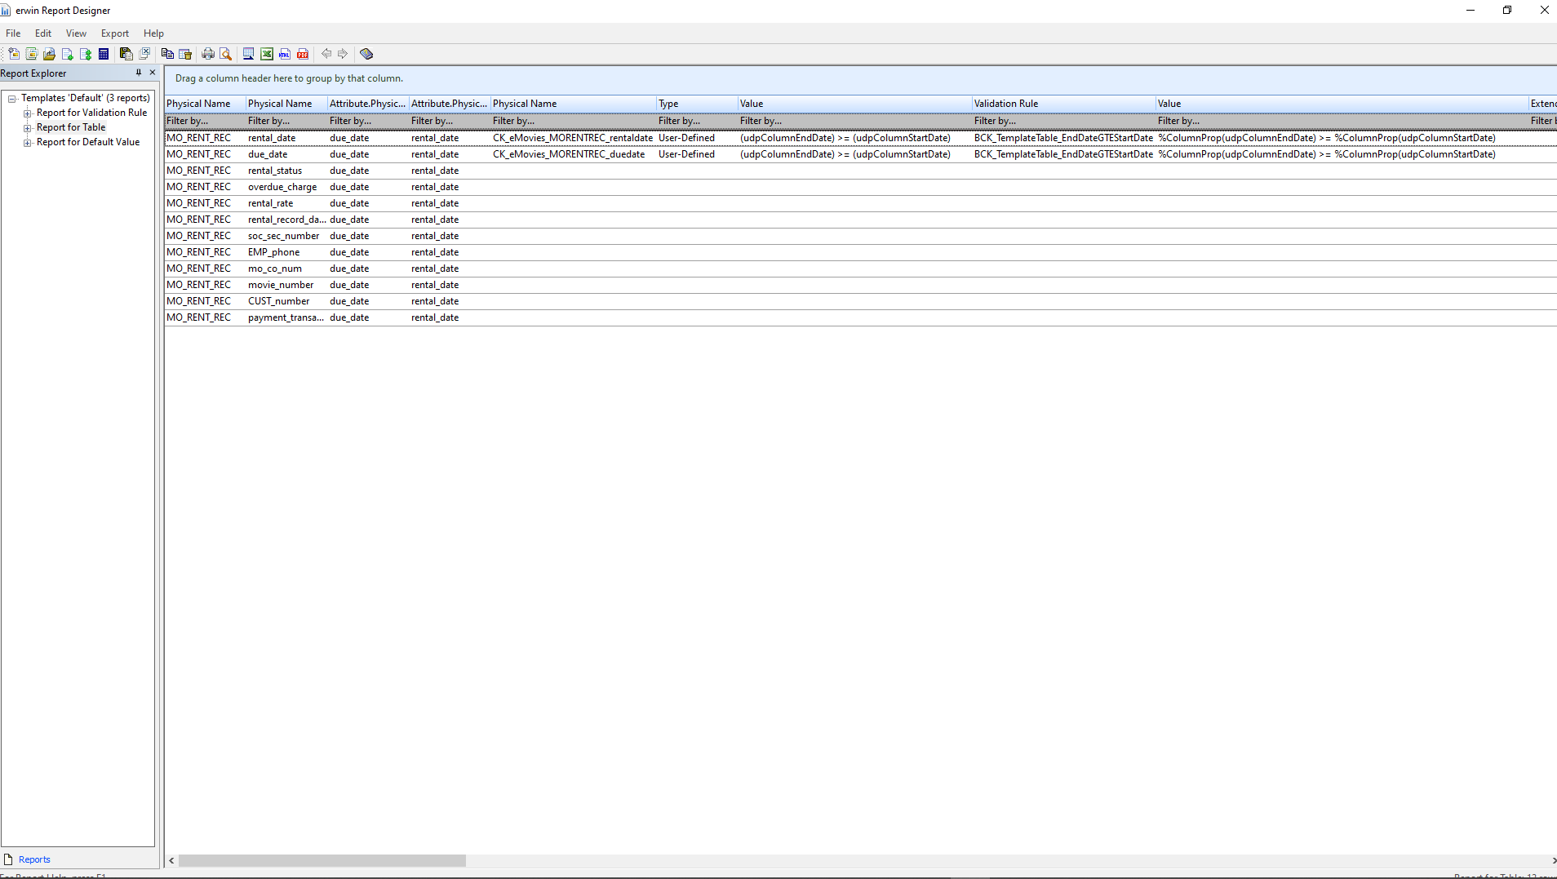
Generating reports(Table, UDP)
Notes:
This report generated is using the report designer to show the report on Tables and its attributes. This shows that the UDP can be used for every column and can be changed accordingly.

Slide 6
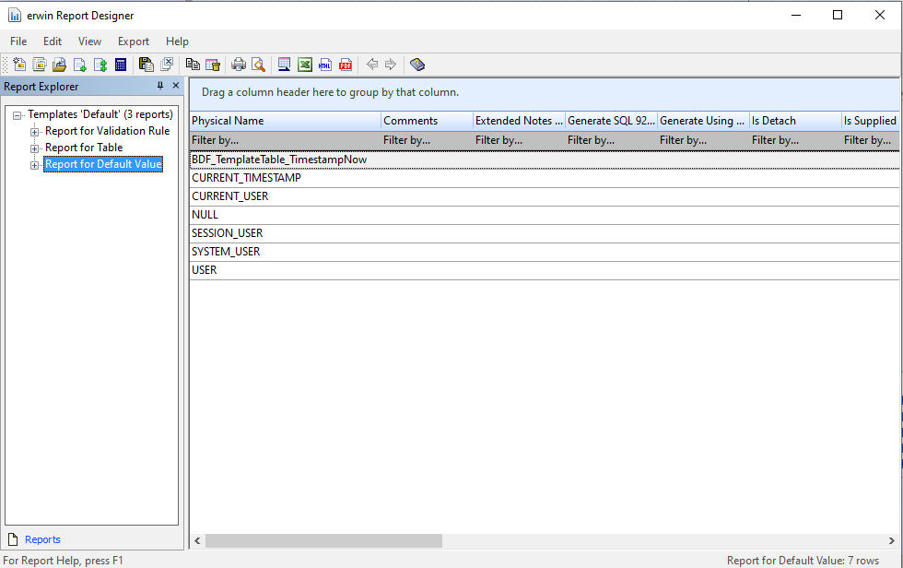
Generating reports(Default Value)
Notes:
This report generated is using the report designer to show the report on Default Value and the templates created. Which is used by the Movie_Rental_Records table.

Slide 7
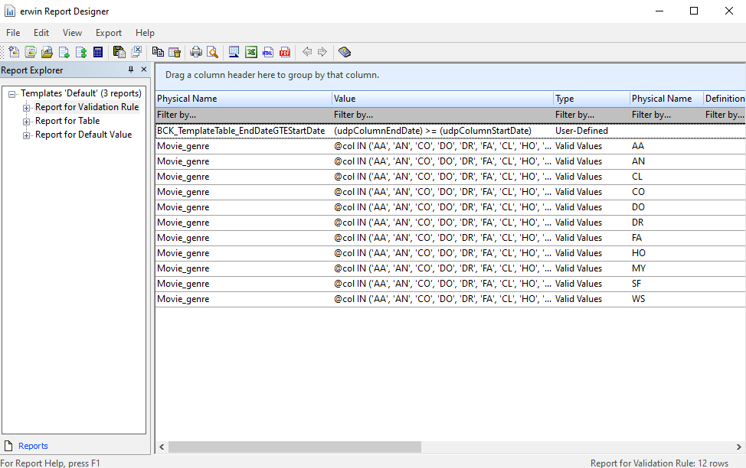
Generating reports(Validation Rules)
Notes:
This report generated is using the report designer to show the report on Validation rule. It shows the validation rule we created for Movie_Rental_Records table for the attributes rental_date and due_date using the custom udp to define start and end date, with EndDate being after the StartDate ie EndDate being the due_date and StartDate being the rental_date

Slide 8
Conclusion
These tools exist for us to utilize, facilitating improved teamwork and communication. They also streamline the database development process, enabling teams to systematically collaborate on a model.

